Slide 1
DB 프로젝트 10조 최종발표
김소정
김현기
이주호

Slide 2
CONTENTS
01 ERD/릴레이션
02 ERwin 다이어그램
03 SQL
04 SQL 활용 예시

Slide 3
수정된 파트
ShowTime_Seat 수정
Actor_Movie 수정
Company-Movie 관계 추가
ShowTime_Seat 수정 (더이상 3진관계 아님)
장르 다치 변경(복합키 구성)
Role 변경
실제 구현단계에서는 seat의 row와 col 없앰
코로나 관련 예제를 포함해도 좋을듯 (ㅇㅇㅇ고객이 확진되었는데, ㅇㅇㅇ고객과 같은 상영관에서 같은 영화를 본 고객의 이름과 전화번호 모두 추출)
IsBooked 구현이 어려운건 아닌데 너무 나중에 생각나서 삭제했습니다

Slide 4
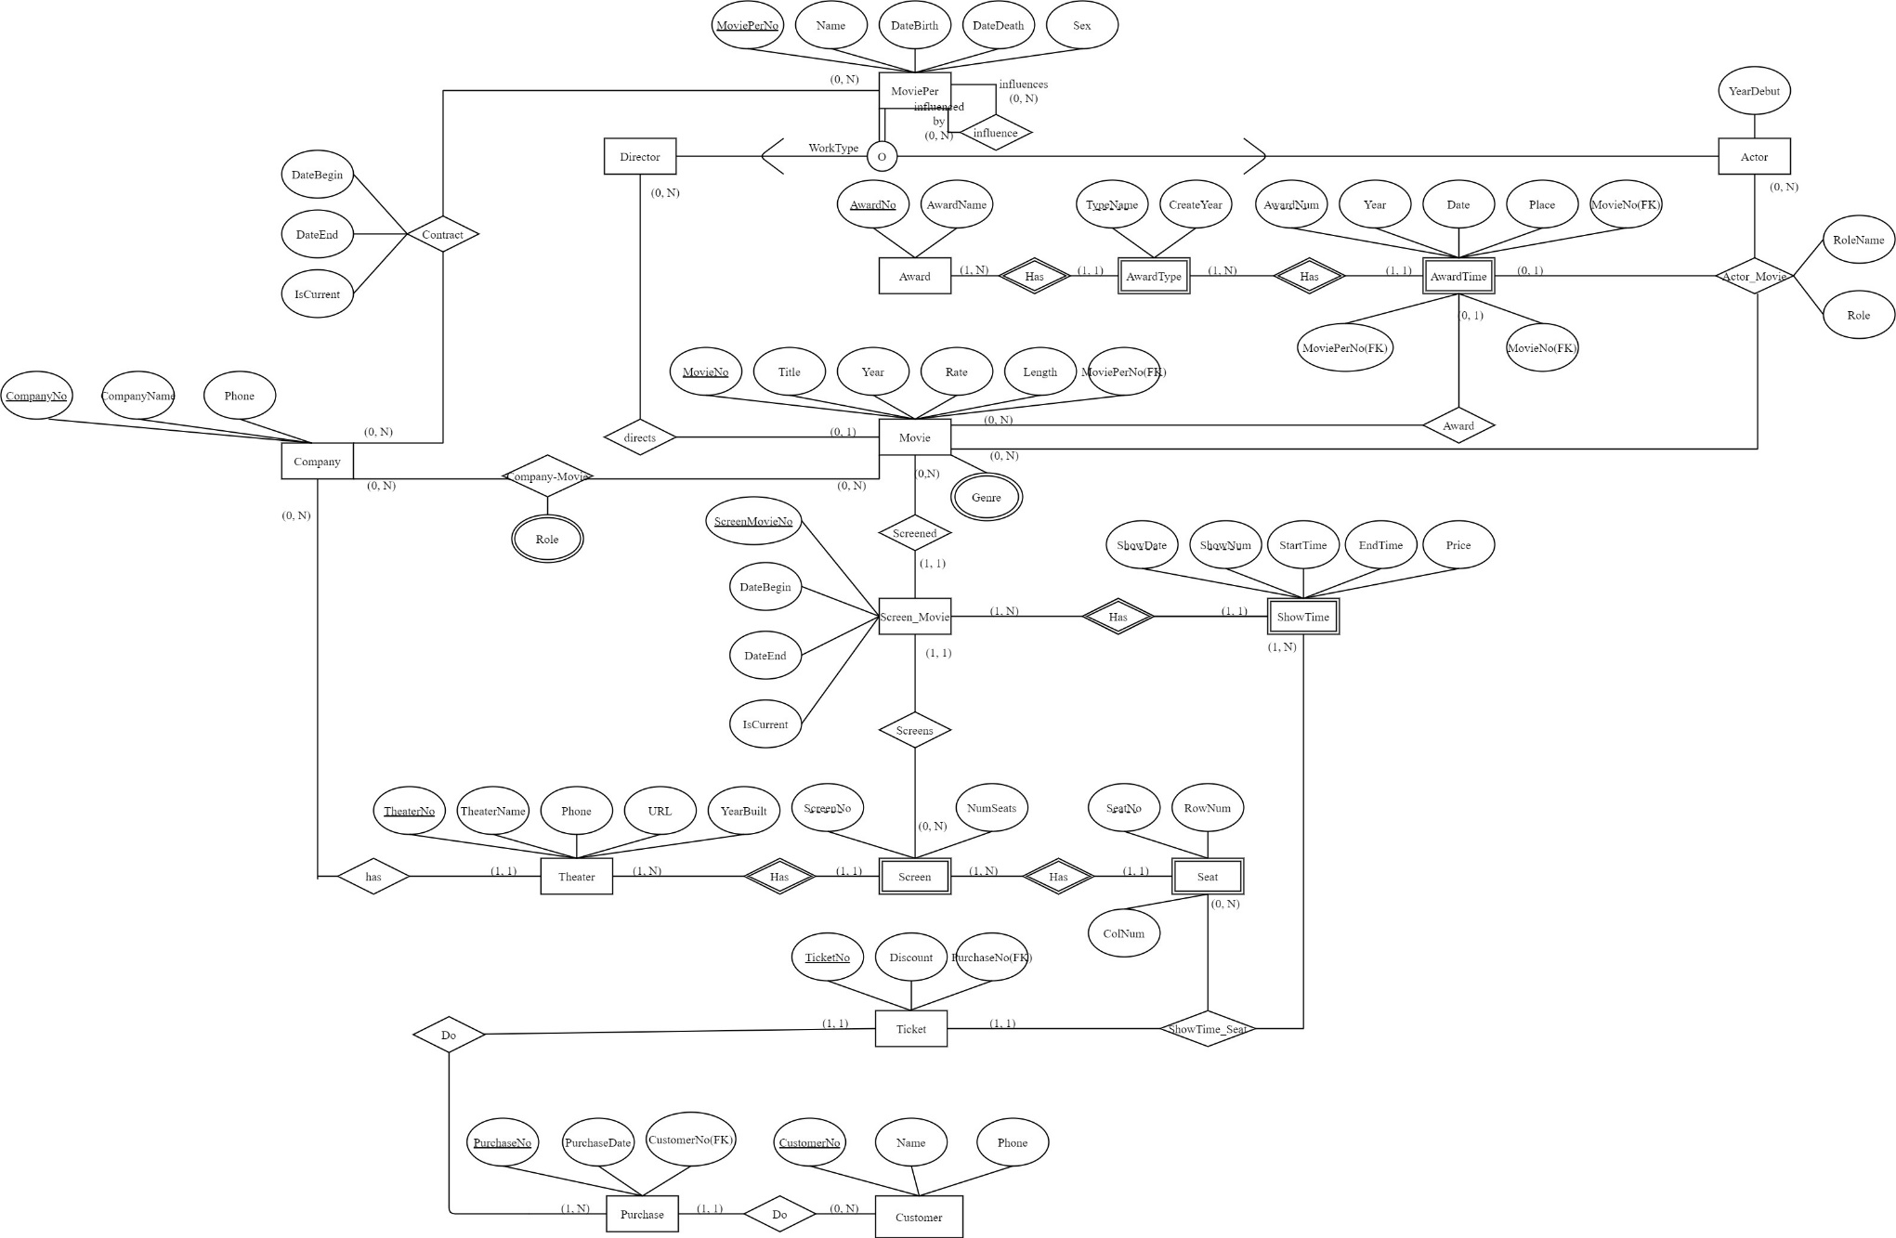
ERD

Slide 5
릴레이션
1. 강한 개체
Company (CompanyNo, CompanyName, Phone)
MoviePer (MoviePerNo, Name, DateBirth, DateDeath, Sex)
Award (AwardNo, AwardName)
Movie(MovieNo, Title, Year, Rate, Length)
Theater (TheaterNo, TheaterName, Phone, URL, YearBuilt)
Screen (ScreenNo, NumSeats)
Screen-Movie(ScreenMovieNo, DateBegin, DateEnd, IsCurrent)
Ticket (TicketNo, Discount)
Customer (CustomerNo, Name, Phone)
Purchase (PurchaseNo, PurchaseDate)
2. 약한개체
AwardType (TypeName, AwardNo(FK), CreateYear)
AwardTime (AwardNum, TypeName(FK), AwardNo(FK), Year, Date, Place)
Screen (ScreenNo, TheaterNo(FK), NumSeats)
Seat (SeatNo, ScreenNo(FK), TheaterNO(FK), RowNum, ColNum)
ShowTime (ShowDate, ShowNum, ScreenMovieNo(FK), StartTime, EndTime, Price)

Slide 6
릴레이션
3. 이진 일대일
ShowTime-Seat - Ticket
4. 이진 일대다
Director - Movie
Movie (MovieNo, Title, Year, Rate, Length, MoviePerNo(FK))
Customer - Purchase
Purchase (PurchaseNo, PurchaseDate, CustomerNo(FK))
Purchase - Ticket
Ticket (TicketNo, Discount, PurchaseNo(FK))
Movie - AwardTime
AwardTime (AwardNum,TypeName(FK), AwardNo(FK), Year, Date, Place, MovieNo(FK))
Movie – Screen-Movie
Screen-Movie(ScreenMovieNo, DateBegin, DateEnd, IsCurrent, MovieNo(FK))
Screen – Screen-Movie
Screen-Movie(ScreenMovieNo, DateBegin, DateEnd, IsCurrent, MovieNo(FK), ScreenNo(FK), TheaterNo(FK))
Actor-Movie - AwardTime
AwardTime (AwardNum,TypeName(FK), AwardNo(FK), Year, Date, Place, MovieNo(FK), MoviePerNo(FK), MovieNo(FK))

Slide 7
릴레이션
5. 이진 다대다
Company - MoviePer
Contract (CompanyNo(FK), MoviePerNo(FK), DateBegin, DateEnd, IsCurrent)
Actor - Movie
Actor-Movie (MovieNo(FK), MoviePerNo(FK))
Company - Movie
Company-Movie (CompanyNo(FK), MovieNo(FK))
6. 1진
MoviePerson
Influnce (MoviePerNo(FK), InfluncerNo(FK))
7. 3진 이상
AwardTime - Actor – Movie
Actor-Movie (AwardTimeNo(FK), MoviePerNo(FK), MovieNo(FK), RoleName, Role)
Ticket - Seat - ShowTime
ShowTime-Seat (TicketNo(FK), SeatNo(FK), ScreenNo(FK), TheaterNo(FK), ShowDate(FK), ShowNum(FK), ScreenMovieNo(FK))
8. 다치
Genre (MovieNo, GenreName)
Role (CompanyNo(FK), MovieNo(FK), RoleName)
9. 단일 상속
MoviePer (MoviePerNo, Name, DateBirth, DateDeath, Sex)
Actor (MoviePerNo(FK), YearDebut)
Director (MoviePerNo(FK))

Slide 8
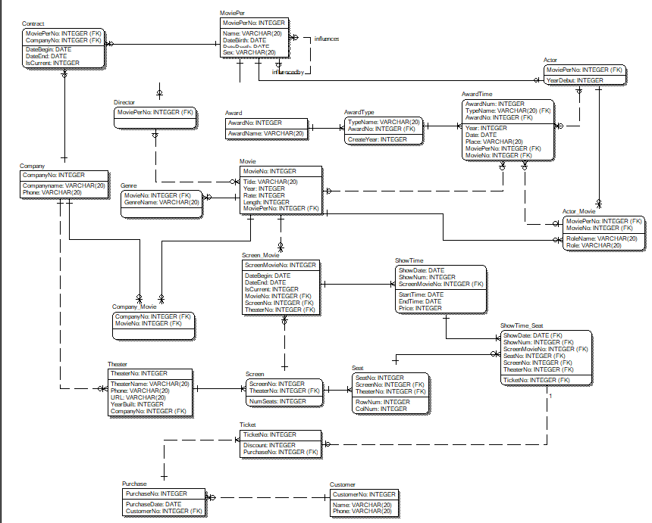
ERwin 다이어그램

Slide 9
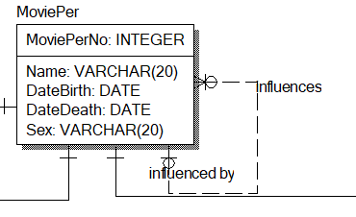
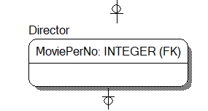
SQL Table 생성
CREATE TABLE MoviePer
(
MoviePerNo INTEGER NOT NULL ,
Name VARCHAR(20) NULL ,
DateBirth DATE NULL ,
DateDeath DATE NULL ,
Sex VARCHAR(20) NULL ,
CONSTRAINT XPKMoviePer PRIMARY KEY (MoviePerNo),
CONSTRAINT R_31 FOREIGN KEY (MoviePerNo) REFERENCES MoviePer(MoviePerNo) ON DELETE SET NULL
);
CREATE TABLE Director
(
MoviePerNo INTEGER NOT NULL ,
CONSTRAINT XPKDirector PRIMARY KEY (MoviePerNo),
CONSTRAINT R_50 FOREIGN KEY (MoviePerNo) REFERENCES MoviePer(MoviePerNo)
);

Slide 10
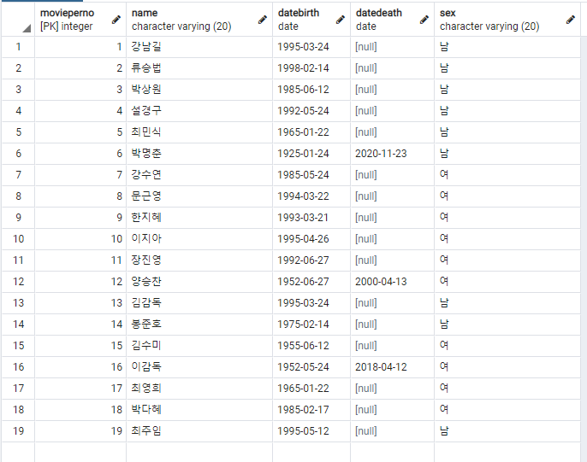
SQL에 데이터 추가
Movieper
insert into movieper values(1, '강남길', '1995-03-24', NULL, '남');
insert into movieper values(2, '류승법', '1998-02-14', NULL, '남');
insert into movieper values(3, '박상원', '1985-06-12', NULL, '남');
insert into movieper values(4, '설경구', '1992-05-24', NULL, '남');
insert into movieper values(5, '최민식', '1965-01-22', NULL, '남');
insert into movieper values(6, '박명춘', '1925-01-24', '2020-11-23', '남');
insert into movieper values(7, '강수연', '1985-05-24', NULL, '여');
insert into movieper values(8, '문근영', '1994-03-22', NULL, '여');
insert into movieper values(9, '한지혜', '1993-03-21', NULL, '여');
insert into movieper values(10, '이지아', '1995-04-26', NULL, '여');
insert into movieper values(11, '장진영', '1992-06-27', NULL, '여');
insert into movieper values(12, '양승찬', '1952-06-27', '2000-04-13', '여');
insert into movieper values(13, '김감독', '1995-03-24', NULL, '남');
insert into movieper values(14, '봉준호', '1975-02-14', NULL, '남');
insert into movieper values(15, '김수미', '1955-06-12', NULL, '여');
insert into movieper values(16, '이감독', '1952-05-24', '2018-04-12', '여');
insert into movieper values(17, '최영희', '1965-01-22', NULL, '여');
insert into movieper values(18, '박다혜', '1985-02-17', NULL, '여');
insert into movieper values(19, '최주임', '1995-05-12', NULL, '남');

Slide 11
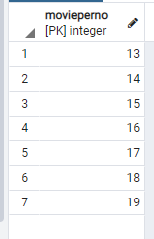
SQL에 데이터 추가
Director
insert into director values(13);
insert into director values(14);
insert into director values(15);
insert into director values(16);
insert into director values(17);
insert into director values(18);
insert into director values(19);

Slide 12
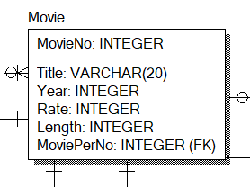
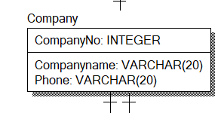
SQL
CREATE TABLE Movie
(
MovieNo INTEGER NOT NULL ,
Title VARCHAR(20) NULL ,
Year INTEGER NULL ,
Rate INTEGER NULL ,
Length INTEGER NULL ,
MoviePerNo INTEGER NULL ,
CONSTRAINT XPKMovie PRIMARY KEY (MovieNo),
CONSTRAINT R_7 FOREIGN KEY (MoviePerNo) REFERENCES Director(MoviePerNo) ON DELETE CASCADE
);
CREATE TABLE Company
(
CompanyNo INTEGER NOT NULL ,
Companyname VARCHAR(20) NULL ,
Phone VARCHAR(20) NULL ,
CONSTRAINT XPKCompany PRIMARY KEY (CompanyNo)
);

Slide 13
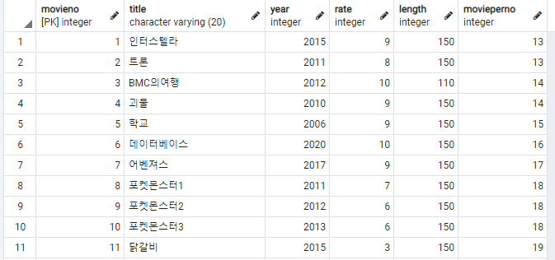
SQL에 데이터 추가
Movie
insert into Movie values(1, '인터스텔라', 2015, 9, 150, 13);
insert into Movie values(2, '트론', 2011, 8, 150, 13);
insert into Movie values(3, 'BMC의여행', 2012, 10, 110, 14);
insert into Movie values(4, '괴물', 2010, 9, 150, 14);
insert into Movie values(5, '학교', 2006, 9, 150, 15);
insert into Movie values(6, '데이터베이스', 2020, 10, 150, 16);
insert into Movie values(7, '어벤져스', 2017, 9, 150, 17);
insert into Movie values(8, '포켓몬스터1', 2011, 7, 150, 18);
insert into Movie values(9, '포켓몬스터2', 2012, 6, 150, 18);
insert into Movie values(10, '포켓몬스터3', 2013, 6, 150, 18);
insert into Movie values(11, '닭갈비', 2015, 3, 150, 19);

Slide 14
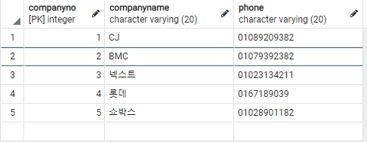
SQL에 데이터 추가
Company
insert into Company values(1, 'CJ', '01089209382');
insert into Company values(2, 'BMC', '01079392382');
insert into Company values(3, '넥스트', '01023134211');
insert into Company values(4, '롯데', '0167189039');
insert into Company values(5, '쇼박스', '01028901182');

Slide 15
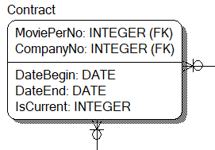
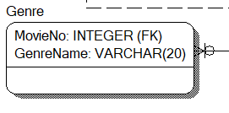
SQL
CREATE TABLE Contract
(
DateBegin DATE NULL ,
DateEnd DATE NULL ,
IsCurrent INTEGER NULL ,
MoviePerNo INTEGER NOT NULL ,
CompanyNo INTEGER NOT NULL ,
CONSTRAINT XPKContract PRIMARY KEY (MoviePerNo,CompanyNo),
CONSTRAINT R_46 FOREIGN KEY (MoviePerNo) REFERENCES MoviePer(MoviePerNo),
CONSTRAINT R_47 FOREIGN KEY (CompanyNo) REFERENCES Company(CompanyNo)
);
CREATE TABLE Genre
(
MovieNo INTEGER NOT NULL ,
GenreName VARCHAR(20) NOT NULL ,
CONSTRAINT XPKGenre PRIMARY KEY (MovieNo,GenreName),
CONSTRAINT R_44 FOREIGN KEY (MovieNo) REFERENCES Movie(MovieNo)
);

Slide 16
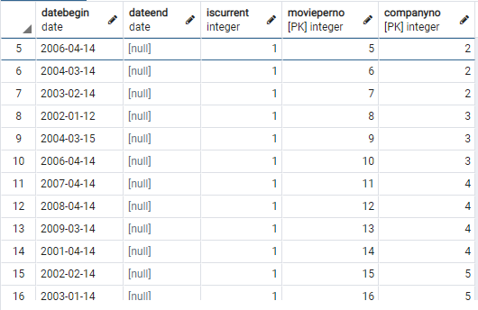
SQL에 데이터 추가
Contract
insert into Contract values('2000-4-14',NULL,1,1,1);
insert into Contract values('2000-3-11',NULL,1,2,1);
insert into Contract values('2000-3-15',NULL,1,3,1);
insert into Contract values('2002-3-14',NULL,1,4,1);
insert into Contract values('2006-4-14',NULL,1,5,2);
insert into Contract values('2004-3-14',NULL,1,6,2);
insert into Contract values('2003-2-14',NULL,1,7,2);
insert into Contract values('2002-1-12',NULL,1,8,3);
insert into Contract values('2004-3-15',NULL,1,9,3);
insert into Contract values('2006-4-14',NULL,1,10,3);
insert into Contract values('2007-4-14',NULL,1,11,4);
insert into Contract values('2008-4-14',NULL,1,12,4);
insert into Contract values('2009-3-14',NULL,1,13,4);
insert into Contract values('2001-4-14',NULL,1,14,4);
insert into Contract values('2002-2-14',NULL,1,15,5);
insert into Contract values('2003-1-14',NULL,1,16,5);
insert into Contract values('2005-4-14',NULL,1,17,5);
insert into Contract values('2006-1-14',NULL,1,18,5);
insert into Contract values('2007-4-14',NULL,1,19,5);

Slide 17
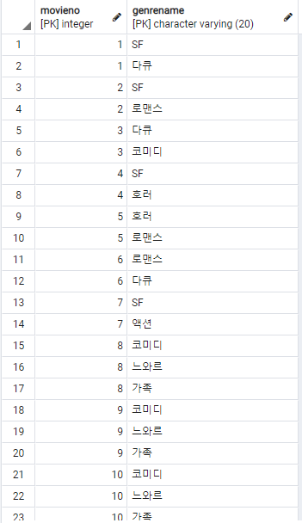
SQL에 데이터 추가
Genre
insert into Genre values(1, 'SF');
insert into Genre values(1, '다큐');
insert into Genre values(2, 'SF');
insert into Genre values(2, '로맨스');
insert into Genre values(3, '다큐');
insert into Genre values(3, '코미디');
insert into Genre values(4, 'SF');
insert into Genre values(4, '호러');
insert into Genre values(5, '호러');
insert into Genre values(5, '로맨스');
insert into Genre values(6, '로맨스');
insert into Genre values(6, '다큐');
insert into Genre values(7, 'SF');
insert into Genre values(7, '액션');
insert into Genre values(8, '코미디');
insert into Genre values(8, '느와르');
insert into Genre values(8, '가족');
insert into Genre values(9, '코미디');
insert into Genre values(9, '느와르');
insert into Genre values(9, '가족');
insert into Genre values(10, '코미디');
insert into Genre values(10, '느와르');
insert into Genre values(10, '가족');
insert into Genre values(11, '다큐');

Slide 18
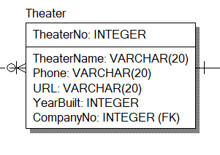
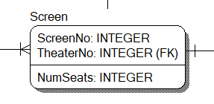
SQL
CREATE TABLE Theater
(
TheaterNo INTEGER NOT NULL ,
TheaterName VARCHAR(20) NULL ,
Phone VARCHAR(20) NULL ,
URL VARCHAR(20) NULL ,
YearBuilt INTEGER NULL ,
CompanyNo INTEGER NOT NULL ,
CONSTRAINT XPKTheater PRIMARY KEY (TheaterNo),
CONSTRAINT R_13 FOREIGN KEY (CompanyNo) REFERENCES Company(CompanyNo)
);
CREATE TABLE Screen
(
ScreenNo INTEGER NOT NULL ,
NumSeats INTEGER NULL ,
TheaterNo INTEGER NOT NULL ,
CONSTRAINT XPKScreen PRIMARY KEY (ScreenNo,TheaterNo),
CONSTRAINT R_12 FOREIGN KEY (TheaterNo) REFERENCES Theater(TheaterNo)
);

Slide 19
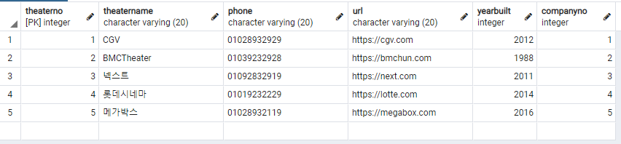
SQL에 데이터 추가
Theater
insert into Theater values(1, 'CGV', '01028932929', 'https://cgv.com', 2012, 1);
insert into Theater values(2, 'BMCTheater', '01039232928', 'https://bmchun.com', 1988, 2);
insert into Theater values(3, '넥스트', '01092832919', 'https://next.com', 2011, 3);
insert into Theater values(4, '롯데시네마', '01019232229', 'https://lotte.com', 2014, 4);
insert into Theater values(5, '메가박스', '01028932119', 'https://megabox.com', 2016, 5);

Slide 20
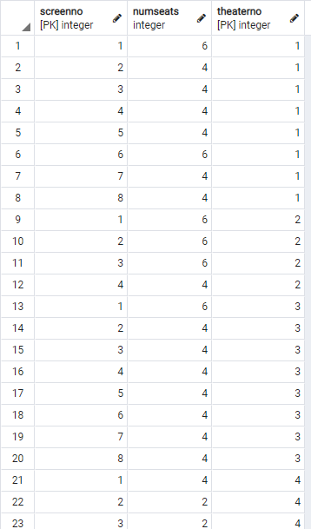
SQL에 데이터 추가
Screen
insert into Screen values(1, 6, 1);
insert into Screen values(2, 4, 1);
insert into Screen values(3, 4, 1);
insert into Screen values(4, 4, 1);
insert into Screen values(5, 4, 1);
insert into Screen values(6, 6, 1);
insert into Screen values(7, 4, 1);
insert into Screen values(8, 4, 1);
insert into Screen values(1, 6, 2);
insert into Screen values(2, 6, 2);
insert into Screen values(3, 6, 2);
insert into Screen values(4, 4, 2);
insert into Screen values(1, 6, 3);
insert into Screen values(2, 4, 3);
insert into Screen values(3, 4, 3);
insert into Screen values(4, 4, 3);
insert into Screen values(5, 4, 3);
insert into Screen values(6, 4, 3);
insert into Screen values(7, 4, 3);
insert into Screen values(8, 4, 3);
insert into Screen values(1, 4, 4);
insert into Screen values(2, 2, 4);
insert into Screen values(3, 2, 4);
insert into Screen values(1, 4, 5);
insert into Screen values(2, 4, 5);
insert into Screen values(3, 4, 5);
insert into Screen values(4, 4, 5);
insert into Screen values(5, 4, 5);
insert into Screen values(6, 4, 5);
insert into Screen values(7, 4, 5);
insert into Screen values(8, 4, 5);
insert into Screen values(9, 4, 5);

Slide 21
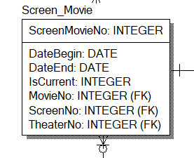
SQL
CREATE TABLE Screen_Movie
(
ScreenMovieNo INTEGER NOT NULL ,
DateBegin DATE NULL ,
DateEnd DATE NULL ,
IsCurrent INTEGER NULL ,
MovieNo INTEGER NOT NULL ,
ScreenNo INTEGER NOT NULL ,
TheaterNo INTEGER NOT NULL ,
CONSTRAINT XPKScreen_Movie PRIMARY KEY (ScreenMovieNo),
CONSTRAINT R_8 FOREIGN KEY (MovieNo) REFERENCES Movie(MovieNo),
CONSTRAINT R_34 FOREIGN KEY (ScreenNo,TheaterNo) REFERENCES Screen(ScreenNo,TheaterNo)
);

Slide 22
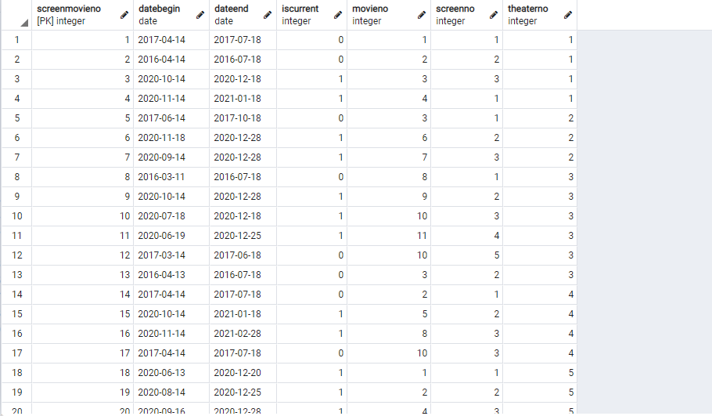
SQL에 데이터 추가
Screen_Movie
insert into Screen_Movie values(1, '2017-04-14', '2017-07-18', 0, 1, 1, 1);
insert into Screen_Movie values(2, '2016-04-14', '2016-07-18', 0, 2, 2, 1);
insert into Screen_Movie values(3, '2020-10-14', '2020-12-18', 1, 3, 3, 1);
insert into Screen_Movie values(4, '2020-11-14', '2021-1-18', 1, 4, 1, 1);
insert into Screen_Movie values(5, '2017-06-14', '2017-10-18', 0, 3, 1, 2);
insert into Screen_Movie values(6, '2020-11-18', '2020-12-28', 1, 6, 2, 2);
insert into Screen_Movie values(7, '2020-09-14', '2020-12-28', 1, 7, 3, 2);
insert into Screen_Movie values(8, '2016-03-11', '2016-07-18', 0, 8, 1, 3);
insert into Screen_Movie values(9, '2020-10-14', '2020-12-28', 1, 9, 2, 3);
insert into Screen_Movie values(10, '2020-07-18', '2020-12-18', 1, 10, 3, 3);
insert into Screen_Movie values(11, '2020-06-19', '2020-12-25', 1, 11, 4, 3);
insert into Screen_Movie values(12, '2017-03-14', '2017-06-18', 0, 10, 5, 3);
insert into Screen_Movie values(13, '2016-04-13', '2016-07-18', 0, 3, 2, 3);
insert into Screen_Movie values(14, '2017-04-14', '2017-07-18', 0, 2, 1, 4);
insert into Screen_Movie values(15, '2020-10-14', '2021-01-18', 1, 5, 2, 4);
insert into Screen_Movie values(16, '2020-11-14', '2021-02-28', 1, 8, 3, 4);
insert into Screen_Movie values(17, '2017-04-14', '2017-07-18', 0, 10, 3, 4);
insert into Screen_Movie values(18, '2020-06-13', '2020-12-20', 1, 1, 1, 5);
insert into Screen_Movie values(19, '2020-08-14', '2020-12-25', 1, 2, 2, 5);
insert into Screen_Movie values(20, '2020-09-16', '2020-12-28', 1, 4, 3, 5);
insert into Screen_Movie values(21, '2015-04-14', '2015-07-18', 0, 7, 4, 5);

Slide 23
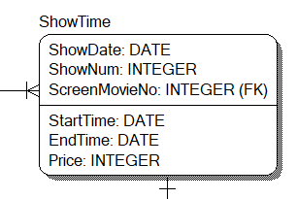
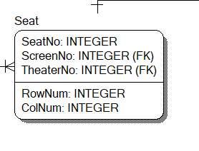
SQL
CREATE TABLE ShowTime
(
ShowDate DATE NOT NULL ,
ShowNum INTEGER NOT NULL ,
StartTime VARCHAR(30) NULL ,
EndTime VARCHAR(30) NULL ,
Price INTEGER NULL ,
ScreenMovieNo INTEGER NOT NULL ,
CONSTRAINT XPKShowTime PRIMARY KEY (ShowDate,ShowNum,ScreenMovieNo),
CONSTRAINT R_9 FOREIGN KEY (ScreenMovieNo) REFERENCES Screen_Movie(ScreenMovieNo)
);
CREATE TABLE Seat
(
SeatNo INTEGER NOT NULL ,
ScreenNo INTEGER NOT NULL ,
TheaterNo INTEGER NOT NULL ,
CONSTRAINT XPKSeat PRIMARY KEY (SeatNo,ScreenNo,TheaterNo),
CONSTRAINT R_11 FOREIGN KEY (ScreenNo,TheaterNo) REFERENCES Screen(ScreenNo,TheaterNo)
);

Slide 24
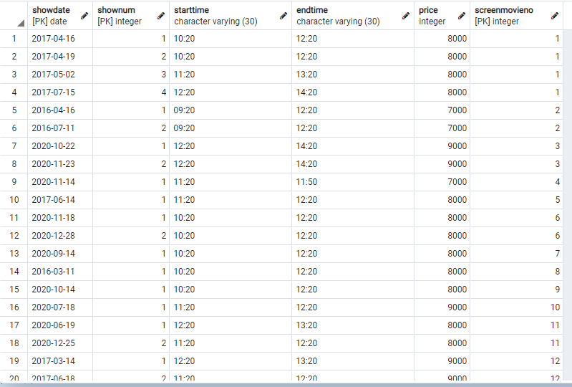
SQL에 데이터 추가
ShowTime
insert into ShowTime values('2017-04-16', 1, '10:20', '12:20', 8000, 1);
insert into ShowTime values('2017-04-19', 2, '10:20', '12:20', 8000, 1);
insert into ShowTime values('2017-05-02', 3, '11:20', '13:20', 8000, 1);
insert into ShowTime values('2017-07-15', 4, '12:20', '14:20', 8000, 1);
insert into ShowTime values('2016-04-16', 1, '09:20', '12:20', 7000, 2);
insert into ShowTime values('2016-07-11', 2, '09:20', '12:20', 7000, 2);
insert into ShowTime values('2020-10-22', 1, '12:20', '14:20', 9000, 3);
insert into ShowTime values('2020-11-23', 2, '12:20', '14:20', 9000, 3);
insert into ShowTime values('2020-11-14', 1, '11:20', '11:50', 7000, 4);
insert into ShowTime values('2017-06-14', 1, '11:20', '12:20', 8000, 5);
insert into ShowTime values('2020-11-18', 1, '10:20', '12:20', 8000, 6);
insert into ShowTime values('2020-12-28', 2, '10:20', '12:20', 8000, 6);
insert into ShowTime values('2020-09-14', 1, '10:20', '12:20', 8000, 7);
insert into ShowTime values('2016-03-11', 1, '10:20', '12:20', 8000, 8);
insert into ShowTime values('2020-10-14', 1, '10:20', '12:20', 8000, 9);
insert into ShowTime values('2020-07-18', 1, '11:20', '12:20', 9000, 10);
insert into ShowTime values('2020-06-19', 1, '12:20', '13:20', 8000, 11);
insert into ShowTime values('2020-12-25', 2, '11:20', '12:20', 8000, 11);
insert into ShowTime values('2017-03-14', 1, '12:20', '13:20', 9000, 12);
insert into ShowTime values('2017-06-18', 2, '11:20', '12:20', 9000, 12);
insert into ShowTime values('2016-04-13', 1, '13:20', '15:20', 8000, 13);
insert into ShowTime values('2016-05-13', 2, '11:20', '13:20', 8000, 13);
insert into ShowTime values('2016-06-13', 3, '15:20', '17:20', 8000, 13);
insert into ShowTime values('2017-04-14', 1, '12:20', '14:20', 9000, 14);
insert into ShowTime values('2020-10-14', 1, '16:20', '17:20', 8000, 15);
insert into ShowTime values('2020-11-14', 1, '13:20', '15:20', 8000, 16);
insert into ShowTime values('2017-04-14', 1, '17:20', '20:20', 8000, 17);
insert into ShowTime values('2020-06-13', 1, '18:20', '20:20', 8000, 18);
insert into ShowTime values('2020-08-14', 1, '19:20', '21:20', 8000, 19);
insert into ShowTime values('2020-09-16', 1, '11:20', '13:20', 6000, 20);
insert into ShowTime values('2020-12-28', 2, '12:20', '14:20', 6000, 20);
insert into ShowTime values('2015-04-14', 1, '13:20', '15:20', 8000, 21);

Slide 25
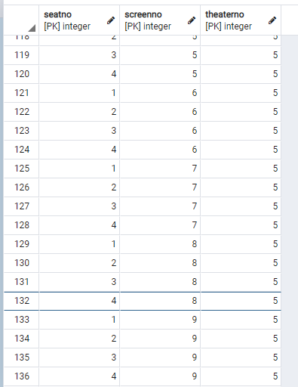
SQL에 데이터 추가
Seat. 영화관 별로 추가
--1번 Theater
insert into seat values(1, 1, 1);
insert into seat values(2, 1, 1);
insert into seat values(3, 1, 1);
insert into seat values(4, 1, 1);
insert into seat values(5, 1, 1);
insert into seat values(6, 1, 1);
insert into seat values(1, 2, 1);
insert into seat values(2, 2, 1);
insert into seat values(3, 2, 1);
insert into seat values(4, 2, 1);
insert into seat values(1, 3, 1);
insert into seat values(2, 3, 1);
insert into seat values(3, 3, 1);
insert into seat values(4, 3, 1);
Etc…
Seat. 영화관 별로 추가
--2번 Theater
insert into seat values(1, 1, 2);
insert into seat values(2, 1, 2);
insert into seat values(3, 1, 2);
insert into seat values(4, 1, 2);
insert into seat values(5, 1, 2);
insert into seat values(6, 1, 2);
insert into seat values(1, 2, 2);
insert into seat values(2, 2, 2);
insert into seat values(3, 2, 2);
insert into seat values(4, 2, 2);
insert into seat values(5, 2, 2);
insert into seat values(6, 2, 2);
Etc…
Seat. 영화관 별로 추가
--3번 Theater
insert into seat values(1, 1, 3);
insert into seat values(2, 1, 3);
insert into seat values(3, 1, 3);
insert into seat values(4, 1, 3);
insert into seat values(5, 1, 3);
insert into seat values(6, 1, 3);
insert into seat values(1, 2, 3);
insert into seat values(2, 2, 3);
insert into seat values(3, 2, 3);
insert into seat values(4, 2, 3);
Etc…
Seat. 영화관 별로 추가
--4번 Theater
insert into seat values(1, 1, 4);
insert into seat values(2, 1, 4);
insert into seat values(3, 1, 4);
insert into seat values(4, 1, 4);
insert into seat values(1, 2, 4);
insert into seat values(2, 2, 4);
insert into seat values(1, 3, 4);
insert into seat values(2, 3, 4);
Etc…
Seat. 영화관 별로 추가
--5번 Theater
insert into seat values(1, 1, 5);
insert into seat values(2, 1, 5);
insert into seat values(3, 1, 5);
insert into seat values(4, 1, 5);
insert into seat values(1, 2, 5);
insert into seat values(2, 2, 5);
insert into seat values(3, 2, 5);
insert into seat values(4, 2, 5);
Etc…
총 136개의 좌석

Slide 26
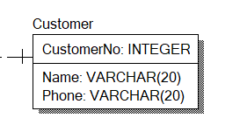
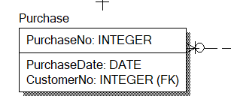
SQL
CREATE TABLE Customer
(
CustomerNo INTEGER NOT NULL ,
Name VARCHAR(20) NULL ,
Phone VARCHAR(20) NULL ,
CONSTRAINT XPKCustomer PRIMARY KEY (CustomerNo)
);
CREATE TABLE Purchase
(
PurchaseNo INTEGER NOT NULL ,
PurchaseDate DATE NULL ,
CustomerNo INTEGER NOT NULL ,
CONSTRAINT XPKPurchase PRIMARY KEY (PurchaseNo),
CONSTRAINT R_16 FOREIGN KEY (CustomerNo) REFERENCES Customer(CustomerNo)
);

Slide 27
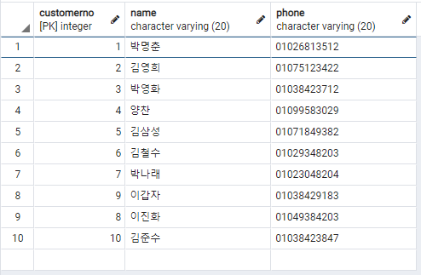
SQL에 데이터 추가
Customer
insert into Customer values(1, '박명춘', '01026813512');
insert into Customer values(2, '김영희', '01075123422');
insert into Customer values(3, '박영화', '01038423712');
insert into Customer values(4, '양찬', '01099583029');
insert into Customer values(5, '김삼성', '01071849382');
insert into Customer values(6, '김철수', '01029348203');
insert into Customer values(7, '박나래', '01023048204');
insert into Customer values(9, '이갑자', '01038429183');
insert into Customer values(8, '이진화', '01049384203');
insert into Customer values(10, '김준수', '01038423847');

Slide 28
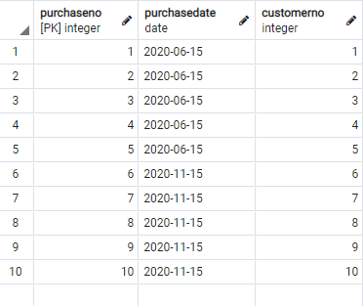
SQL에 데이터 추가
Purchase
insert into Purchase values(1, '2020-06-15', 1);
insert into Purchase values(2, '2020-06-15', 2);
insert into Purchase values(3, '2020-06-15', 3);
insert into Purchase values(4, '2020-06-15', 4);
insert into Purchase values(5, '2020-06-15', 5);
insert into Purchase values(6, '2020-11-15', 6);
insert into Purchase values(7, '2020-11-15', 7);
insert into Purchase values(8, '2020-11-15', 8);
insert into Purchase values(9, '2020-11-15', 9);
insert into Purchase values(10, '2020-11-15', 10);

Slide 29
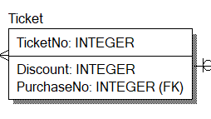
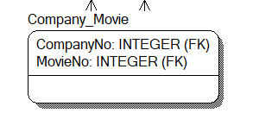
SQL
CREATE TABLE Ticket
(
TicketNo INTEGER NOT NULL ,
Discount INTEGER NULL ,
PurchaseNo INTEGER NOT NULL ,
CONSTRAINT XPKTicket PRIMARY KEY (TicketNo),
CONSTRAINT R_17 FOREIGN KEY (PurchaseNo) REFERENCES Purchase(PurchaseNo)
);
CREATE TABLE Company_Movie
(
CompanyNo INTEGER NOT NULL ,
MovieNo INTEGER NOT NULL ,
CONSTRAINT XPKCompany_Movie PRIMARY KEY (CompanyNo,MovieNo),
CONSTRAINT R_53 FOREIGN KEY (CompanyNo) REFERENCES Company(CompanyNo),
CONSTRAINT R_55 FOREIGN KEY (MovieNo) REFERENCES Movie(MovieNo)
);

Slide 30
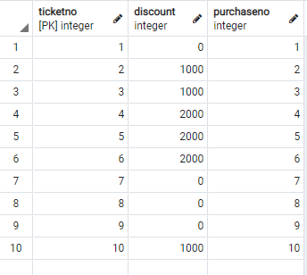
SQL에 데이터 추가
Ticket (고객이 다 같은 영화를 봤다고 가정)
insert into Ticket values(1, 0, 1);
insert into Ticket values(2, 1000, 2);
insert into Ticket values(3, 1000, 3);
insert into Ticket values(4, 2000, 4);
insert into Ticket values(5, 2000, 5);
insert into Ticket values(6, 2000, 6);
insert into Ticket values(7, 0, 7);
insert into Ticket values(8, 0, 8);
insert into Ticket values(9, 0, 9);
insert into Ticket values(10, 1000, 10);

Slide 31
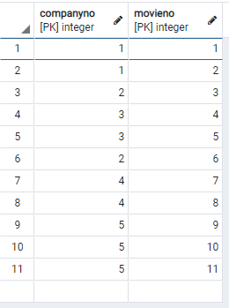
SQL에 데이터 추가
Company_movie
insert into Company_Movie values(1, 1);
insert into Company_Movie values(1, 2);
insert into Company_Movie values(2, 3);
insert into Company_Movie values(3, 4);
insert into Company_Movie values(3, 5);
insert into Company_Movie values(2, 6);
insert into Company_Movie values(4, 7);
insert into Company_Movie values(4, 8);
insert into Company_Movie values(5, 9);
insert into Company_Movie values(5, 10);
insert into Company_Movie values(5, 11);

Slide 32
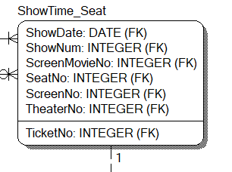
SQL
CREATE TABLE ShowTime_Seat
(
ShowDate DATE NOT NULL ,
ShowNum INTEGER NOT NULL ,
ScreenMovieNo INTEGER NOT NULL ,
SeatNo INTEGER NOT NULL ,
ScreenNo INTEGER NOT NULL ,
TheaterNo INTEGER NOT NULL ,
TicketNo INTEGER NULL ,
CONSTRAINT XPKShowTime_Seat PRIMARY KEY (ShowDate,ShowNum,ScreenMovieNo,SeatNo,ScreenNo,TheaterNo),
CONSTRAINT R_56 FOREIGN KEY (ShowDate,ShowNum,ScreenMovieNo) REFERENCES ShowTime(ShowDate,ShowNum,ScreenMovieNo),
CONSTRAINT R_58 FOREIGN KEY (SeatNo,ScreenNo,TheaterNo) REFERENCES Seat(SeatNo,ScreenNo,TheaterNo),
CONSTRAINT R_61 FOREIGN KEY (TicketNo) REFERENCES Ticket(TicketNo) ON DELETE SET NULL
);

Slide 33
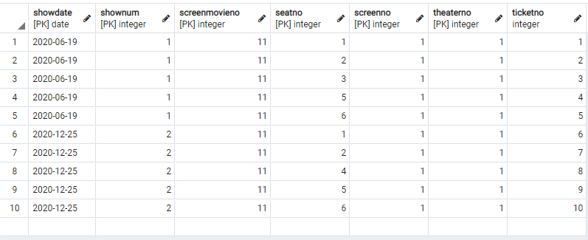
SQL에 데이터 추가
ShowTime_Seat
insert into ShowTime_Seat values('2020-06-19', 1, 11, 1, 1, 1, 1);
insert into ShowTime_Seat values('2020-06-19', 1, 11, 2, 1, 1, 2);
insert into ShowTime_Seat values('2020-06-19', 1, 11, 3, 1, 1, 3);
insert into ShowTime_Seat values('2020-06-19', 1, 11, 5, 1, 1, 4);
insert into ShowTime_Seat values('2020-06-19', 1, 11, 6, 1, 1, 5);
insert into ShowTime_Seat values('2020-12-25', 2, 11, 1, 1, 1, 6);
insert into ShowTime_Seat values('2020-12-25', 2, 11, 2, 1, 1, 7);
insert into ShowTime_Seat values('2020-12-25', 2, 11, 4, 1, 1, 8);
insert into ShowTime_Seat values('2020-12-25', 2, 11, 5, 1, 1, 9);
insert into ShowTime_Seat values('2020-12-25', 2, 11, 6, 1, 1, 10);

Slide 34
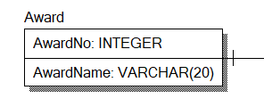
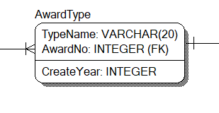
SQL
CREATE TABLE Award
(
AwardNo INTEGER NOT NULL ,
AwardName VARCHAR(20) NULL ,
CONSTRAINT XPKAward PRIMARY KEY (AwardNo)
);
CREATE TABLE AwardType
(
TypeName VARCHAR(20) NOT NULL ,
CreateYear INTEGER NULL ,
AwardNo INTEGER NOT NULL ,
CONSTRAINT XPKAwardType PRIMARY KEY (TypeName,AwardNo),
CONSTRAINT R_1 FOREIGN KEY (AwardNo) REFERENCES Award(AwardNo)
);

Slide 35
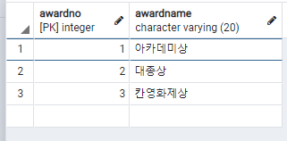
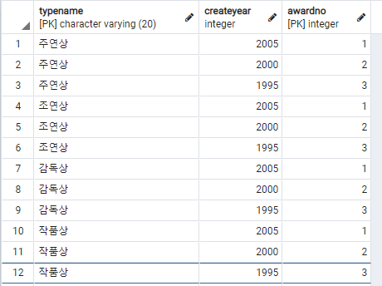
SQL에 데이터 추가
Award
insert into Award values(1, '아카데미상');
insert into Award values(2, '대종상');
insert into Award values(3, '칸영화제상');
AwardType
insert into AwardType values('주연상',2005,1);
insert into AwardType values('주연상',2000,2);
insert into AwardType values('주연상',1995,3);
insert into AwardType values('조연상',2005,1);
insert into AwardType values('조연상',2000,2);
insert into AwardType values('조연상',1995,3);
insert into AwardType values('감독상',2005,1);
insert into AwardType values('감독상',2000,2);
insert into AwardType values('감독상',1995,3);
insert into AwardType values('작품상',2005,1);
insert into AwardType values('작품상',2000,2);
insert into AwardType values('작품상',1995,3);

Slide 36
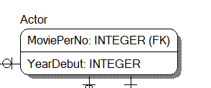
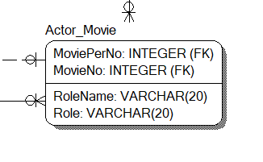
SQL
CREATE TABLE Actor
(
YearDebut INTEGER NULL ,
MoviePerNo INTEGER NOT NULL ,
CONSTRAINT XPKActor PRIMARY KEY (MoviePerNo),
CONSTRAINT R_51 FOREIGN KEY (MoviePerNo) REFERENCES MoviePer(MoviePerNo)
);
CREATE TABLE Actor_Movie
(
MoviePerNo INTEGER NOT NULL ,
MovieNo INTEGER NOT NULL ,
RoleName VARCHAR(20) NULL ,
Role VARCHAR(20) NULL ,
CONSTRAINT XPKActor_Movie PRIMARY KEY (MoviePerNo,MovieNo),
CONSTRAINT R_42 FOREIGN KEY (MoviePerNo) REFERENCES Actor(MoviePerNo),
CONSTRAINT R_43 FOREIGN KEY (MovieNo) REFERENCES Movie(MovieNo)
);

Slide 37
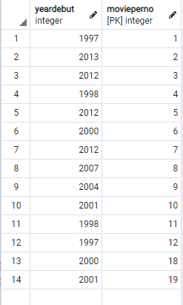
SQL에 데이터 추가
Actor
insert into actor values(1997,1);
insert into actor values(2013,2);
insert into actor values(2012,3);
insert into actor values(1998,4);
insert into actor values(2012,5);
insert into actor values(2000,6);
insert into actor values(2012,7);
insert into actor values(2007,8);
insert into actor values(2004,9);
insert into actor values(2001,10);
insert into actor values(1998,11);
insert into actor values(1997,12);
insert into actor values(2000,18);
insert into actor values(2001,19);

Slide 38
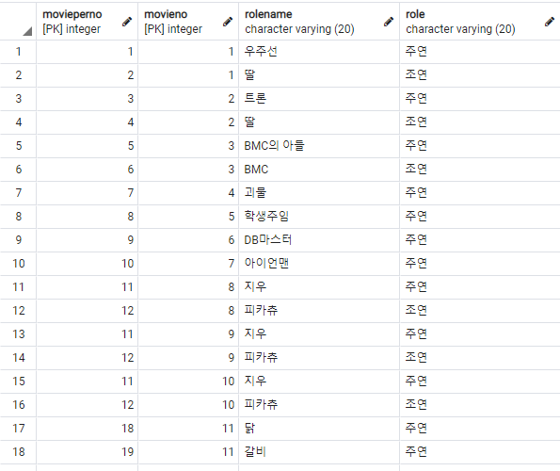
SQL에 데이터 추가
Actor_Movie
insert into Actor_Movie values(1,1,'우주선','주연');
insert into Actor_Movie values(2,1,'딸','조연');
insert into Actor_Movie values(3,2,'트론','주연');
insert into Actor_Movie values(4,2,'딸','조연');
insert into Actor_Movie values(5,3,'BMC의 아들','주연');
insert into Actor_Movie values(6,3,'BMC','조연');
insert into Actor_Movie values(7,4,'괴물','주연');
insert into Actor_Movie values(8,5,'학생주임','주연');
insert into Actor_Movie values(9,6,'DB마스터','주연');
insert into Actor_Movie values(10,7,'아이언맨','주연');
insert into Actor_Movie values(11,8,'지우','주연');
insert into Actor_Movie values(12,8,'피카츄','조연');
insert into Actor_Movie values(11,9,'지우','주연');
insert into Actor_Movie values(12,9,'피카츄','조연');
insert into Actor_Movie values(11,10,'지우','주연');
insert into Actor_Movie values(12,10,'피카츄','조연');
insert into Actor_Movie values(18,11,'닭','주연');
insert into Actor_Movie values(19,11,'갈비','주연');

Slide 39
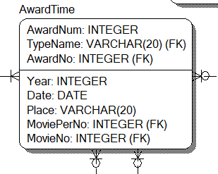
SQL
CREATE TABLE AwardTime
(
AwardNum INTEGER NOT NULL ,
Year INTEGER NULL ,
Date DATE NULL ,
Place VARCHAR(20) NULL ,
TypeName VARCHAR(20) NOT NULL ,
AwardNo INTEGER NOT NULL ,
MoviePerNo INTEGER NULL ,
MovieNo INTEGER NULL ,
CONSTRAINT XPKAwardTime PRIMARY KEY (AwardNum,TypeName,AwardNo),
CONSTRAINT R_5 FOREIGN KEY (TypeName,AwardNo) REFERENCES AwardType(TypeName,AwardNo),
CONSTRAINT R_30 FOREIGN KEY (MoviePerNo) REFERENCES Actor(MoviePerNo) ON DELETE SET NULL,
CONSTRAINT R_48 FOREIGN KEY (MovieNo) REFERENCES Movie(MovieNo) ON DELETE SET NULL,
CONSTRAINT R_52 FOREIGN KEY (MoviePerNo,MovieNo) REFERENCES Actor_Movie(MoviePerNo,MovieNo) ON DELETE SET NULL
);

Slide 40
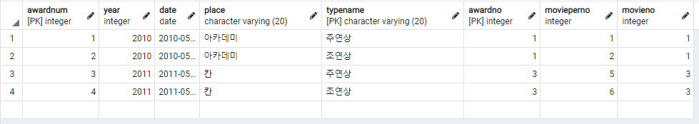
SQL에 데이터 추가
AwardTime
insert into AwardTime values(1, 2010, '2010-05-15', '아카데미', '주연상', 1, 1, 1);
insert into AwardTime values(2, 2010, '2010-05-15', '아카데미', '조연상', 1, 2, 1);
insert into AwardTime values(3, 2011, '2011-05-15', '칸', '주연상', 3, 5, 3);
insert into AwardTime values(4, 2011, '2011-05-15', '칸', '조연상', 3, 6, 3);

Slide 41
SQL 활용 예시

Slide 42
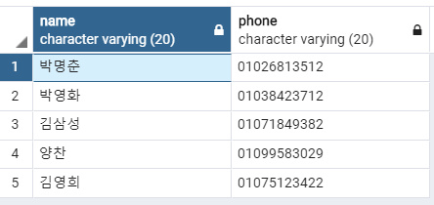
SQL 활용 예시1
1. 이름을 검색하면 함께 영화를 본 관객들의 이름과 휴대폰 번호가 뜸
select name, phone from Customer
where customerno in (select customerno from Purchase
where purchaseno in (select purchaseno from Ticket
where ticketno in (select ticketno from showtime_seat where (showdate, shownum, screenno, theaterno) = (select showdate, shownum, screenno, theaterno from showtime_seat
where ticketno = (select ticketno from Ticket where purchaseno =
(select purchaseno from Purchase where customerno =
(select customerno from Customer where name = '박명춘')))))))

Slide 43
SQL 활용 예시2
이름을 검색하면 함께 영화를 본 관객들의 이름과 휴대폰 번호가 뜸
이런 질의를 조인으로하던데 얻고자 하는 값이 customerno에만 있기도 하고
해서 속도 향상과 효율을 위해서 부속질의를 사용
select name, phone from Customer
where customerno in (select customerno from Purchase
where purchaseno in (select purchaseno from Ticket
where ticketno in (select ticketno from showtime_seat where (showdate, shownum, screenno, theaterno) = (select showdate, shownum, screenno, theaterno from showtime_seat
where ticketno = (select ticketno from Ticket where purchaseno =
(select purchaseno from Purchase where customerno =
(select customerno from Customer where name = '박명춘')))))))

Slide 44
SQL 활용 예시1
1. 이름을 검색하면 함께 영화를 본 관객들의 이름과 휴대폰 번호가 뜸
select name, phone from Customer
where customerno in (select customerno from Purchase
where purchaseno in (select purchaseno from Ticket
where ticketno in (select ticketno from showtime_seat where (showdate, shownum, screenno, theaterno) = (select showdate, shownum, screenno, theaterno from showtime_seat
where ticketno = (select ticketno from Ticket where purchaseno =
(select purchaseno from Purchase where customerno =
(select customerno from Customer where name = '박명춘')))))))

Slide 45
SQL 활용 예시1
1. 이름을 검색하면 함께 영화를 본 관객들의 이름과 휴대폰 번호가 뜸
select name, phone from Customer
where customerno in (select customerno from Purchase
where purchaseno in (select purchaseno from Ticket
where ticketno in (select ticketno from showtime_seat where (showdate, shownum, screenno, theaterno) = (select showdate, shownum, screenno, theaterno from showtime_seat
where ticketno = (select ticketno from Ticket where purchaseno =
(select purchaseno from Purchase where customerno =
(select customerno from Customer where name = '박명춘')))))))

Slide 46
SQL 활용 예시1
1. 이름을 검색하면 함께 영화를 본 관객들의 이름과 휴대폰 번호가 뜸
select name, phone from Customer
where customerno in (select customerno from Purchase
where purchaseno in (select purchaseno from Ticket
where ticketno in (select ticketno from showtime_seat where (showdate, shownum, screenno, theaterno) = (select showdate, shownum, screenno, theaterno from showtime_seat
where ticketno = (select ticketno from Ticket where purchaseno =
(select purchaseno from Purchase where customerno =
(select customerno from Customer where name = '박명춘')))))))

Slide 47
THANK YOU

